Slide 1
Information Theory and Coding Module 3: Lossless Compression Techniques
Presented By:
Dr. Saladi Saritha
Associate Professor,
School of Electronics Engineering
VIT-AP University

Slide 2
TOPICS TO BE COVERED
Source Coding Theorem,
Uniquely Decodable codes,
Instantaneous Codes,
Kraft-McMillan Inequality,
Shannon Fano coding,
Huffman coding,
Minimum variance Huffman coding,
Arithmetic coding.
Dictionary Coding- Lempel-Ziv-Welch (LZW) coding.

Slide 3
Source Coding
The Code produced by a discrete memoryless source, has to be efficiently represented, which is an important problem in communications. For this to happen, there are code words, which represent these source codes.
the process of encoding the information source message to a binary code word, and lossless and faithful decoding from the binary code word to the original information source message.
Ex: For example, in telegraphy, we use Morse code, in which the alphabets are denoted by Marks and Spaces. If the letter E is considered, which is mostly used, it is denoted by “.” Whereas the letter Q which is rarely used, is denoted by “--.-”

Slide 4
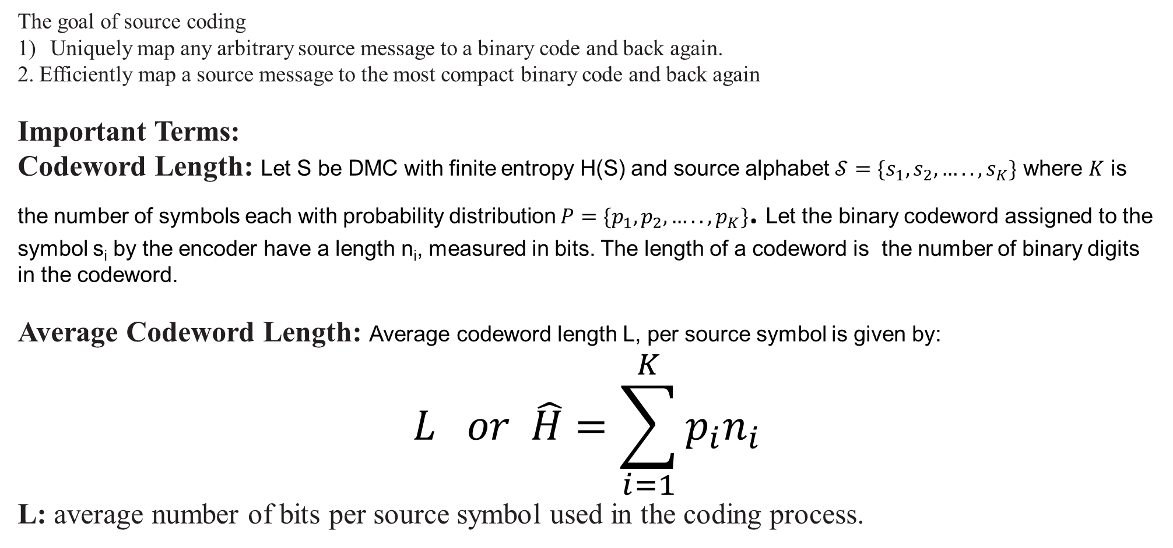
Source Coding
The goal of source coding
Uniquely map any arbitrary source message to a binary code and back again.
2. Efficiently map a source message to the most compact binary code and back again
Important Terms:
Codeword Length: Let S be DMC with finite entropy H(S) and source alphabet $𝒮=\{s_{1}, s_{2},….., s_{K}\}$ where $K$ is the number of symbols each with probability distribution $P=\{p_{1}, p_{2},….., p_{K}\}$. Let the binary codeword assigned to the symbol s_{i} by the encoder have a length n_{i}, measured in bits. The length of a codeword is the number of binary digits in the codeword.
Average Codeword Length: Average codeword length L, per source symbol is given by:
$$L or \hat{H}=\sum_{i=1}^{K}{p_{i}n_{i}}$$
L: average number of bits per source symbol used in the coding process.

Slide 5
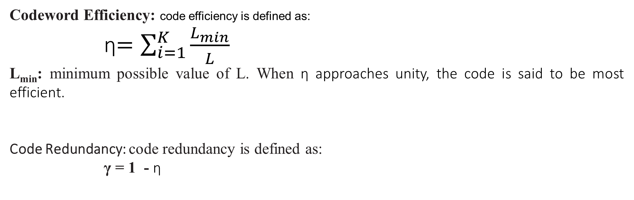
Source Coding
Codeword Efficiency: code efficiency is defined as:
ⴄ$=\sum_{i=1}^{K}{\frac{L_{min}}{L}}$
L_{min}: minimum possible value of L. When ⴄ approaches unity, the code is said to be most efficient.
Code Redundancy: code redundancy is defined as:
γ = 1 - ⴄ

Slide 6
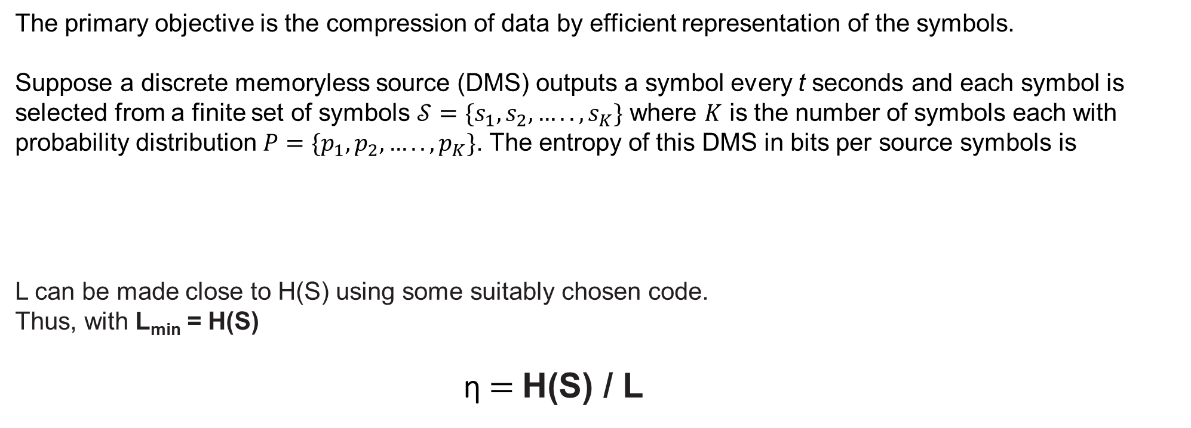
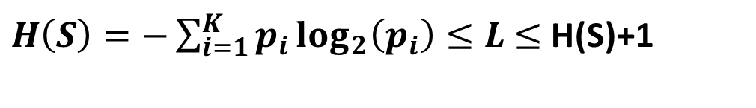
Source Coding Theorem
The primary objective is the compression of data by efficient representation of the symbols.
Suppose a discrete memoryless source (DMS) outputs a symbol every t seconds and each symbol is selected from a finite set of symbols $𝒮=\{s_{1}, s_{2},….., s_{K}\}$ where $K$ is the number of symbols each with probability distribution $P=\{p_{1}, p_{2},….., p_{K}\}$. The entropy of this DMS in bits per source symbols is
L can be made close to H(S) using some suitably chosen code.
Thus, with L_{min} = H(S)
ⴄ $=$H(S) / L
$H\left(S\right)=−\sum_{i=1}^{K}{p_{i}}\log_{2}\left(p_{i}\right)≤L$ $≤$ H(S)+1

Slide 7
Example:
Q: Consider a source X which generates four symbols with probabilities p1 = 0.5, p2 = 0.3, p3 = 0.1 and p4 = 0.1. Calculate average codeword length, and efficiency of this code if the coding scheme is as follow.
1-- 01
2-- 10
3-- 011
4---111

Slide 8
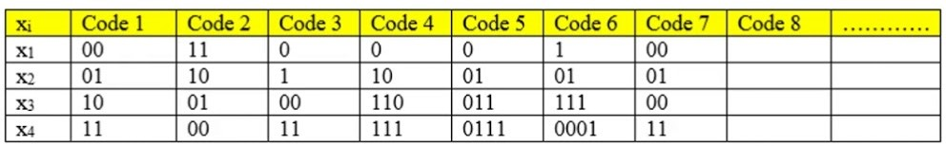
Classification of Codes:
Fixed Length Code: Codeword length is fixed (Code 1,2,7).
Ex: BCD, ASCII
Variable Length Code: Codeword length is not fixed (Code 3,4,5,6).
Ex: Huffman, Shannon-Fano, Lempel-Ziv
Distinct Codes: Each codeword is distinguishable from other codeword. (code 7: x1 and x3 same so non a distinct code.)
Prefix free code: No codeword should be prefix of other codeword (Code 3 is prefix free).
Uniquely decodable codes: Original sequence can be reconstructed perfectly from the encoded sequence. Prefix-free codes are uniquely decodable, but converse is not always true (Code5: Uniquely decodable but not prefix-free).

Slide 9
Classification of Codes:
Instantaneous Code: Prefix-free code sometimes known as instantaneous code (code 1,2).
Optimal Code: a code is optimal if it is instantaneous and minimum L.
Ex: Huffman

Slide 10
Examples
For the given DMS with two symbols x₁ and x_{2,} p(x₁) = 0.9, p(x₂) = 0.1. The symbols x₁ and x₂ is encoded as per the table. Find efficiency and redundancy of this code.
xi | p(xi) | code
x1 | 0.9 | 0
x2 | 0.1 | 1

Slide 11

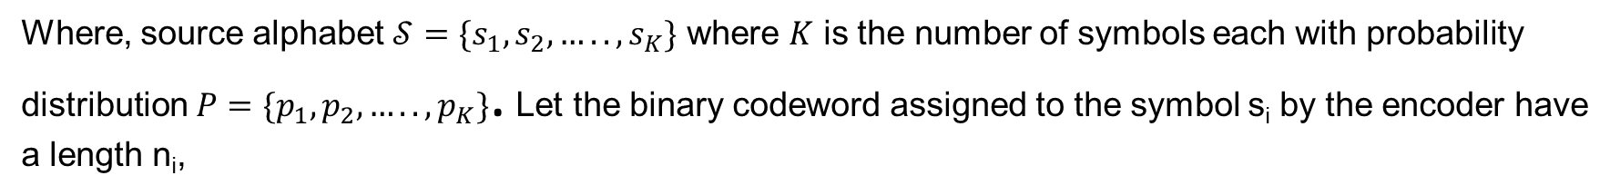
Kraft–McMillan inequality
Kraft–McMillan inequality gives a necessary and sufficient condition for the existence of a prefix code\or a uniquely decodable for a given set of codeword lengths
$$\sum_{i=1}^{K}{2^{−n_{i}}}≤1$$
Where, source alphabet $𝒮=\{s_{1}, s_{2},….., s_{K}\}$ where $K$ is the number of symbols each with probability distribution $P=\{p_{1}, p_{2},….., p_{K}\}$. Let the binary codeword assigned to the symbol s_{i} by the encoder have a length n_{i},

Slide 12
Examples
The table gives four possible binary codes for 4 symbol DMS. Show:
1) All codes except B satisfies the Kraft inequality.
2) Show A and D are uniquely decodable code but B and C are not
xi | Code A | Code B | Code C | Code D
x1 | 00 | 0 | 0 | 0
x2 | 01 | 10 | 11 | 100
x3 | 10 | 11 | 100 | 110
x4 | 11 | 110 | 110 | 111
xi | Code A | Code B | Code C | Code D
x1 | 01 | 0 | 1 | 0
x2 | 11 | 100 | 111 | 010
x3 | 00 | 10 | 00 | 100
x4 | 10 | 101 | 10 | 101
The table gives four possible binary codes for 4 symbol of a DMS.
a) Verify the Kraft inequality of all codes(A,B,C,D).
b) Show A and D are uniquely decodable code

Slide 13
Examples
Steps to find uniquely decodable code (UDC):
Construct a list of all code words.
Check Prefix, if No Prefix-----UDC
Prefix Code
Add dangling suffix (DS) to list
DS = some code word----Not UDC
ii) DS ≠ some code word----UDC
xi | Code A | Code B | Code C | Code D
x1 | 00 | 0 | 0 | 0
x2 | 01 | 10 | 11 | 100
x3 | 10 | 11 | 100 | 110
x4 | 11 | 110 | 110 | 111

Slide 14
Examples
Steps to find uniquely decodable code (UDC):
Construct a list of all code words.
Check Prefix, if No Prefix-----UDC
Prefix Code
Add dangling suffix (DS) to list
DS = some code word----Not UDC
ii) DS ≠ some code word----UDC
xi | Code A | Code B | Code C | Code D
x1 | 00 | 0 | 0 | 0
x2 | 01 | 10 | 11 | 100
x3 | 10 | 11 | 100 | 110
x4 | 11 | 110 | 110 | 111

Slide 15
Shannon Fano coding
It is a variable length, source coding technique.
Designing a variable length code such that its average codeword length approaches the entropy of DMS is also called Entropy Coding: Ex: Shannon-Fano Coding, Huffman Coding.
Steps of Shannon-Fano coding
Step1: List the source symbols in order of decreasing/ non-increasing probabilities.
Step2: Partition the set into two sets that are as close to equiprobable as possible, assign 0 to upper set and 1 to lower set.
Step3: Continue step2 until further partition is not possible

Slide 16
Shannon Fano coding Example
Q: A DMS has four symbols x1, x2, x3, x4 with p(x1)=1/2, p(x2)=1/4, p(x3)=p(x4)=1/8. Construct a Shannon Fano code and show that its coding efficiency is 100 %.
Steps of Shannon-Fano coding
Step1: List the source symbols in order of decreasing/ non-increasing probabilities.
Step2: Partition the set into two sets that are as close to equiprobable as possible, assign 0 to upper set and 1 to lower set.
Step3: Continue step2 until further partition is not possible

Slide 17
Shannon Fano coding Example
Q: A DMS has 8 symbols x1, x2, x3, x4, x5, x6,x7, x8 has probability ¼, ¼, 1/8, 1/8, 1/16, 1/16, 1/16, 1/16, respectively. Construct a Shannon Fano code and find efficiency and redundancy.
Steps of Shannon-Fano coding
Step1: List the source symbols in order of decreasing/ non-increasing probabilities.
Step2: Partition the set into two sets that are as close to equiprobable as possible, assign 0 to upper set and 1 to lower set.
Step3: Continue step2 until further partition is not possible

Slide 18
Shannon Fano coding Example
Q: A DMS has five equally likely symbols
Contract a S-F Code and calculate efficiency.
Contract another S-F code and compare the results.
Steps of Shannon-Fano coding
Step1: List the source symbols in order of decreasing/ non-increasing probabilities.
Step2: Partition the set into two sets that are as close to equiprobable as possible, assign 0 to upper set and 1 to lower set.
Step3: Continue step2 until further partition is not possible

Slide 19
Shannon Fano Elias coding
Expected code length.

Slide 20
Shannon Fano Elias coding
Q: A DMS has 4 symbols x1, x2, x3, x4 has probability 0.25, 0.5, 0.125, 0.125 respectively. Fined the code using Shannon-fano elias coding and find the average codeword length and entropy.

Slide 21
Shannon Fano Elias coding

Slide 22
Huffman Coding
It result in optimal code. Thus, it has highest efficiency.
STEPS:
List the source symbols in order of decreasing probability.
Combine the probability of the two symbols having the lowest probabilities, and record the resultant probabilities, this step is reduction 1. The same procedure is repeated until there are two ordered probabilities remaining.
Start encoding with the last reduction, which consist of exactly two ordered probabilities. Assign 0 as the first digit in the codewords for all the source symbols associated with first probability; assign 1 to the second probability.
Now go back and assign 0 and 1 to the second digit for the two probabilities that were combined in the previous reduction step, retaining all assignments made in step3.
Keep regressing this way until the first column is reached.

Slide 23
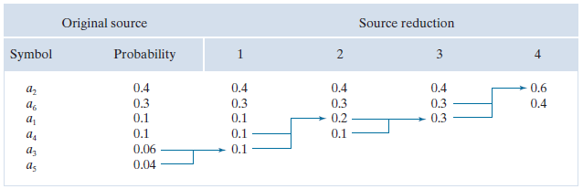
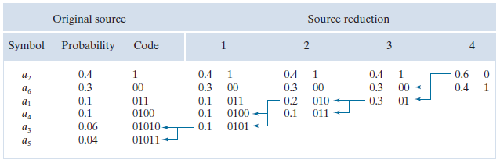
Huffman Coding: Example

Slide 24
Example
Q: A DMS has five symbols x1, x2, x3, x4, x5 with p(x1)=0.4, p(x2)=0.19, p(x3)=0.16, p(x4)= 0.15, p(x5)=0.1.
Construct a Shannon-Fano code and calculate average codeword length.
Repeat for the Huffman code and compare the results.

Slide 25
Example
Q: A DMS has six symbols m1, m2, m3, m4, m5, m6 with p(m1)=0.30, p(m2)=0.25, p(m3)=0.15, p(m4)= 0.12, p(m5)=0.08, p(m6)=0.10. Construct the Huffman code and calculate efficiency and redundancy.
Repeat the same using Shannon Fano coding.

Slide 26
Example
Q: A DMS has five symbols m1, m2, m3, m4, m5 with p(m1)=1/2, p(m2)=1/4, p(m3)=1/8, p(m4)= 1/16, p(m5)=1/16. Construct the Huffman code and calculate efficiency and redundancy.
Repeat the same using Shannon Fano coding.
Q: Generate the binary code using Shannon Fano coding for the given alphabets.
Symbol | A | B | C | D | E | F | G | H
Probability | 0.30 | 0.20 | 0.15 | 0.12 | 0.10 | 0.07 | 0.04 | 0.02
Q: A channel has a bandwidth of 8KHz, what is the channel capacity if signal to noise ratio being 31. For the same channel capacity if signal to noise ratio is increased to 61. what is new channel bandwidth?

Slide 27
Example
Q: Encode the sequence: ‘a b c a d’ using arithmetic coding. P(a)=0.2, P(b)=0.3, P(c)=0.1, P(d)=0.4
Q:A source can generate 3 symbols {a, b, c} with probability P(a)= 0.8, P(b)= 0.02, P(c)= 0.18. The received TAG is ‘0.9663328’, decode the message using arithmetic coding without scaling

